Slide 1
Joint Research Centre
The European Commission’s in-house science service

Slide 2




GuidosToolbox Workshop
Personal: German
Education: Free University Berlin, Germany
1992: MSc Meteorology: atmospheric Rad. Transfer
1997: PhD GeoSciences: RT-vegetation, BRDF, LAI, f_{APAR}
Developer and team member of PCLinuxOS

Slide 3
GuidosToolbox Workshop
The workshop will address the following topics:
1) Introduction and motivation for new ways of pattern analysis
2) MSPA: Morphological Spatial Pattern Analysis
3) GuidosToolbox: program features and processing options
4) Hands-On examples using a training data set:
a) data preparation
b) MSPA, connectivity, fragmentation, contortion, mosaic, …
c) post-processing: exporting to GeoTiff, GoogleEarth overlays

Slide 4
GuidosToolbox Workshop
1) Pattern Analysis:
Introduction/Motivation

Slide 5
Historic evolution
2003 - present
From oil-spills to forests …
Morphological pattern analysis …
From structural to functional pattern …
Combining pattern with connectivity …
Change Analysis …
Fragmentation Analysis…
Cost Analysis …

Slide 6
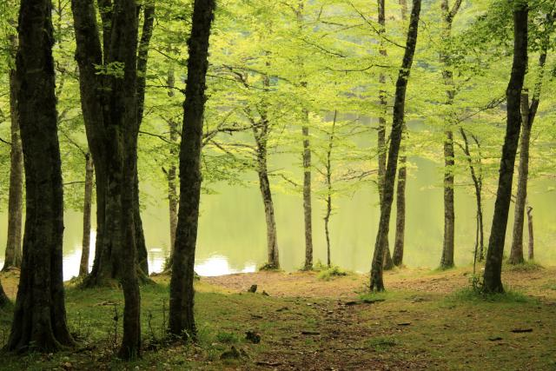

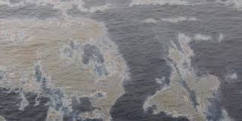
1) From oil-spills to forests …
2003

Slide 7
2003
Background / Motivation: Landscape Metrics (1)
FSP = f (average patch size, total forest area)
FRAGSTATS (McGarigal et al. 1995): software to
calculate more than 100 statistical parameters.
Pro: some meaningful statistics, widely accepted
Con: interdependent, non-intuitive for FSP
7

Slide 8
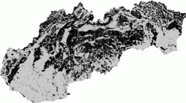
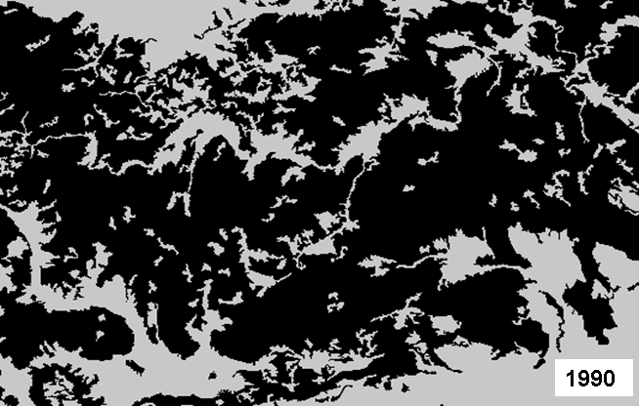
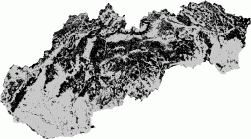
2003
Background / Motivation: Landscape Metrics (1)
1990
2000
Slovakia (CLC):
no change !?
Default reporting: ‘Average Patch Size’ & ‘Total Forest Area’ = constant!
8

Slide 9
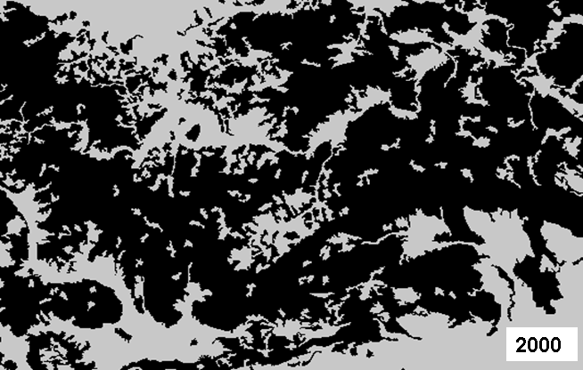
2003
Background / Motivation: Landscape Metrics (1)
1990
2000
Slovakia (CLC):
no change !?
Default reporting: ‘Average Patch Size’ & ‘Total Forest Area’ = constant!
9

Slide 10

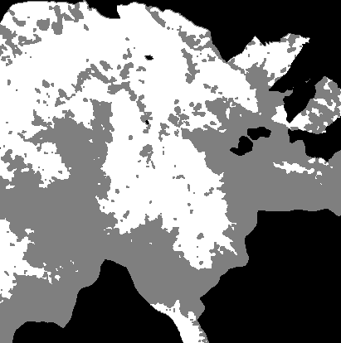

2004
Background / Motivation: Landscape Metrics (1)
Ritters et al. (2000): ‘Kernel’ overlaid over each forested pixel
F
N
F
window
F
F
N
F
F
N
Pf: F-pixels / total: 6/9
Pff: cardinal ( ) pixel pairs with min. one F:
F F / (F F + F N): 5/11
Classifier = f(Pf, Pff)
10

Slide 11
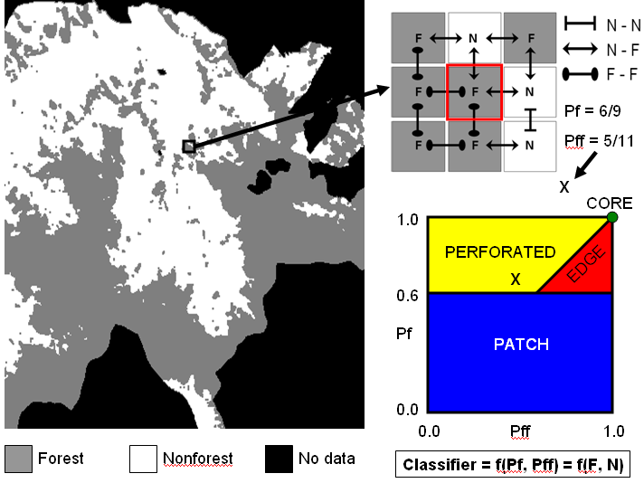
2004
Background / Motivation: Landscape Metrics (1)
11

Slide 12
2004
Background / Motivation: Landscape Metrics (2)
2. FSP = f (PF/PFF); (Riitters et al. 2000):
4 classes: Core, Patch, Perforated, Edge.
Pro: intuitive, independent, flexible, spatial, perforated
Con: confusion at pixel level → no reliable statistics
12

Slide 13
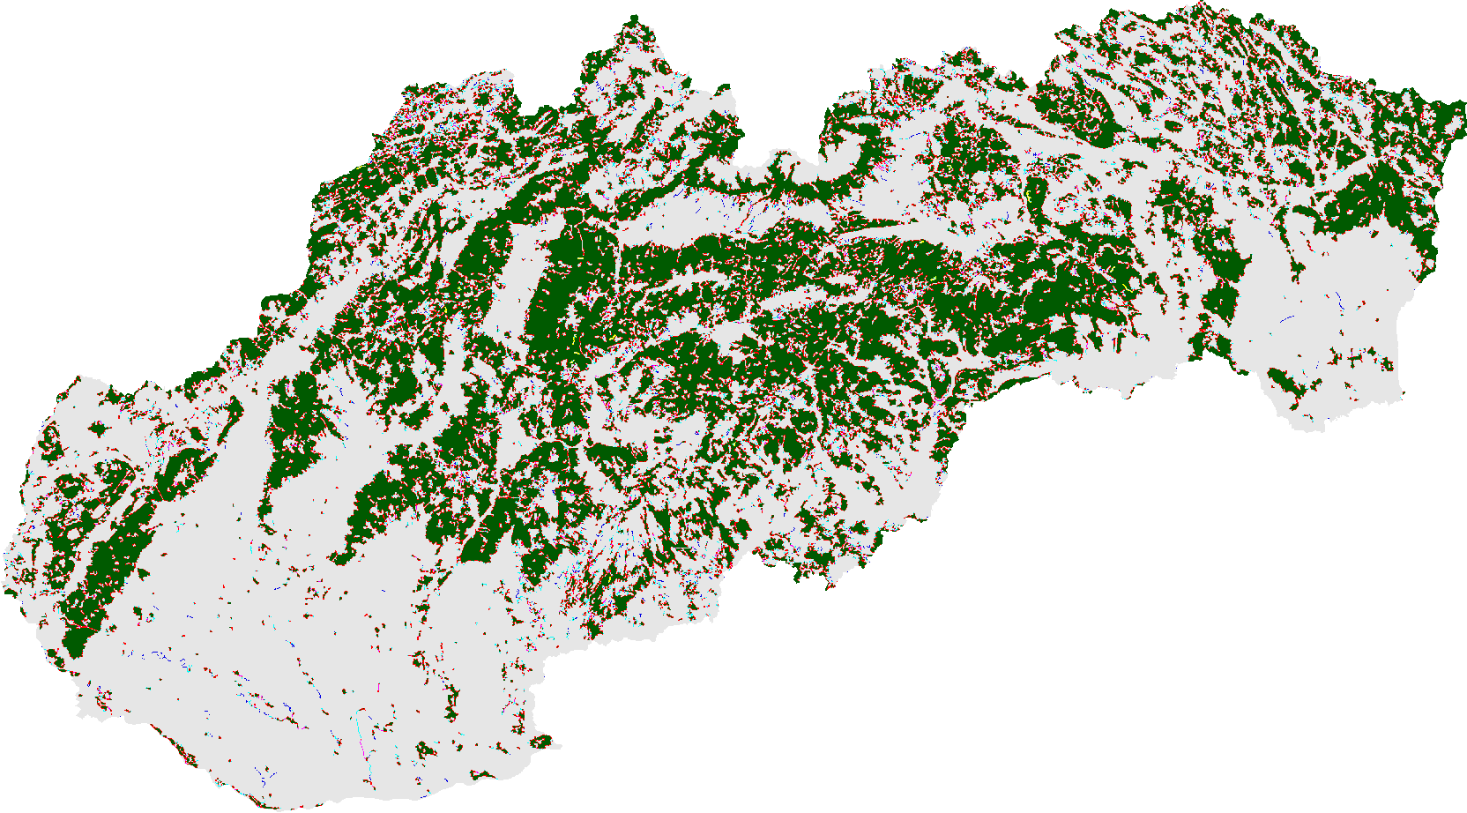
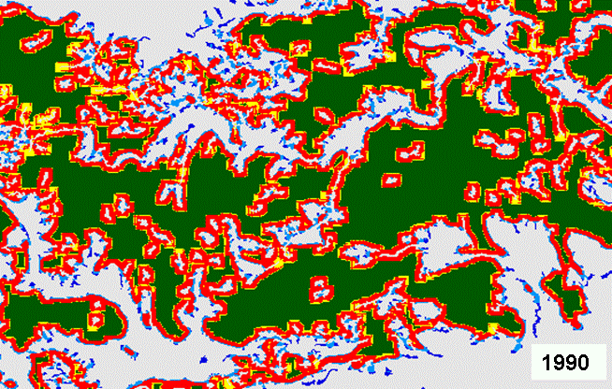
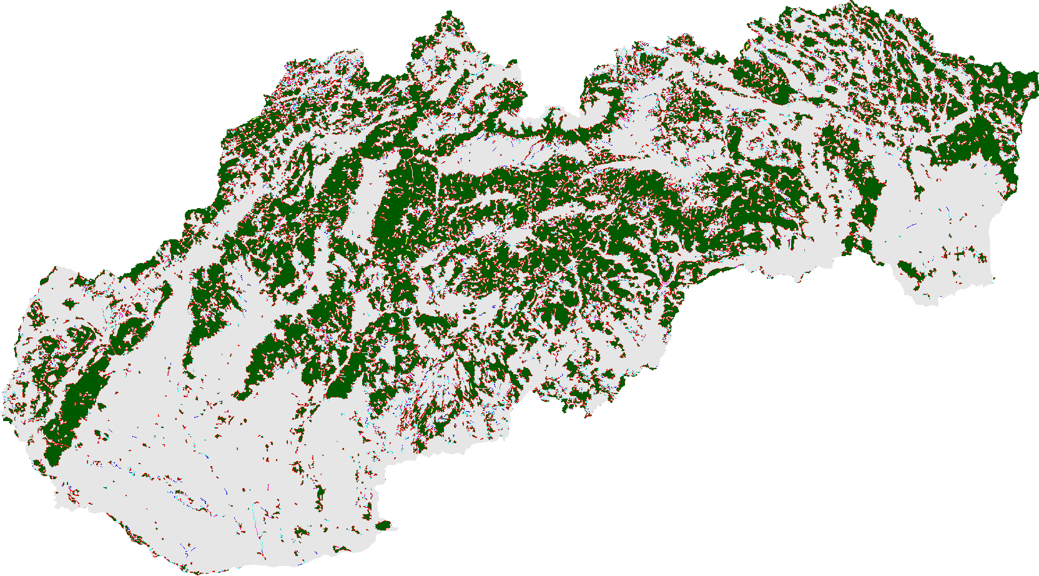
2005
Background / Motivation: Landscape Metrics (2)
1990
2000
Slovakia (CLC):
change!
13

Slide 14
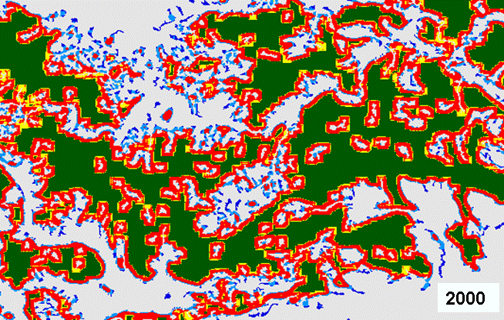
2005
Background / Motivation: Landscape Metrics (2)
1990
2000
Slovakia (CLC):
change!
14

Slide 15
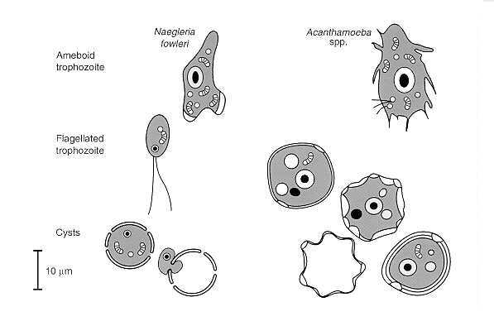
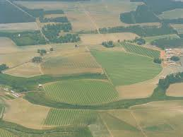
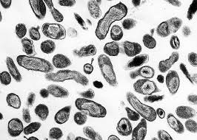
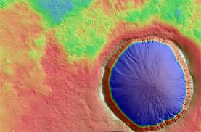
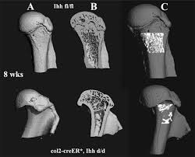
2) Morphological pattern analysis …
2003

Slide 16
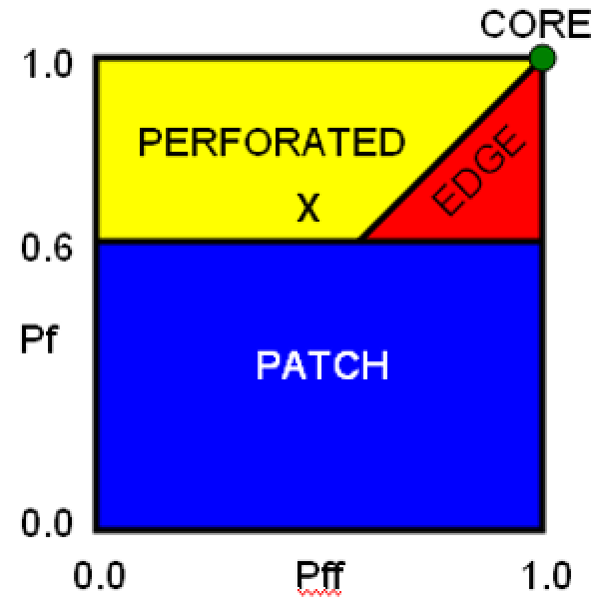
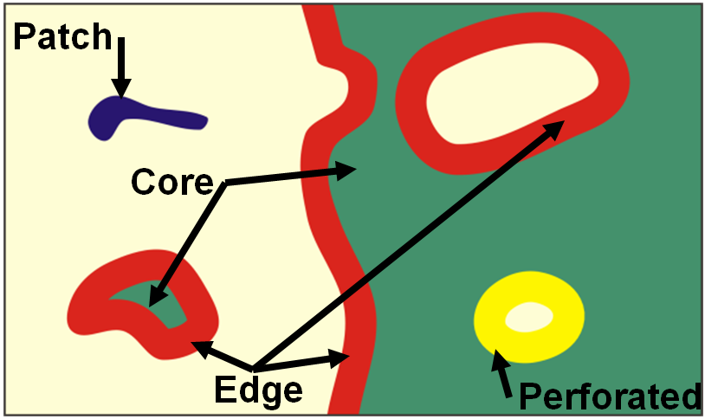
2006
Background / Motivation: MSPA 1
4 classes: PF/PFF
4 classes: morphological
1. Thematic definition of 4 classes
2. Morphological implementation
Analyzing a binary forest mask with morphological
filters to derive the forest spatial pattern classes:
CORE PATCH EDGE PERFORATED
16

Slide 17
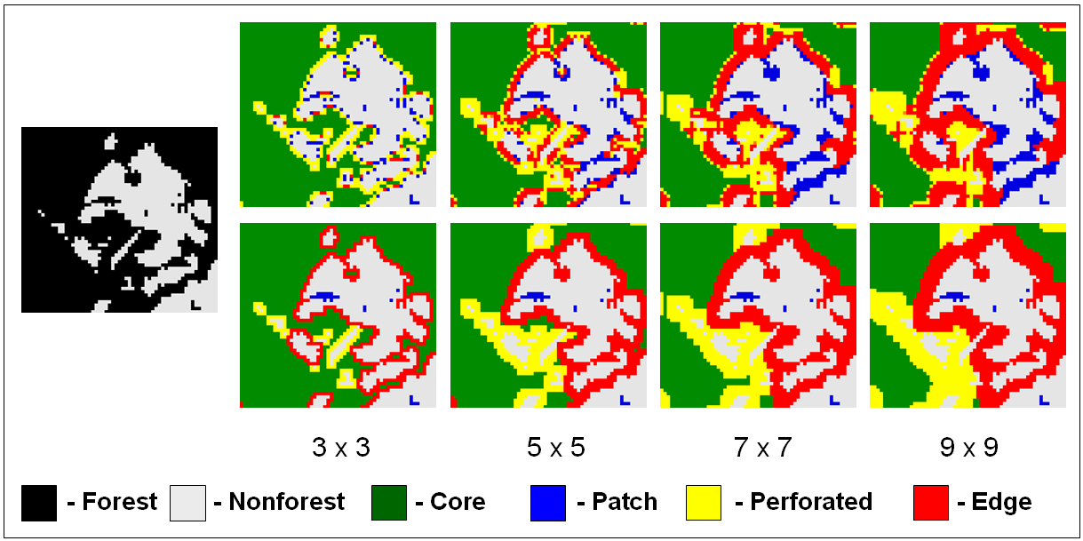
2006
Background / Motivation: MSPA 1
Forest
mask
PF/PFF
MSPA
Window
size/SE
Mapping spatial patterns with morphological image processing (Vogt et al., Landscape Ecol. (2007) 22:171–177)
17

Slide 18
2007
Background / Motivation: MSPA 1
3. FSP = f (morphology); (Vogt et al. 2006):
4 classes: Core, Patch, Perforated, Edge.
Pro: precise, reliable statistics
Con: new concept, not well known yet…
18

Slide 19
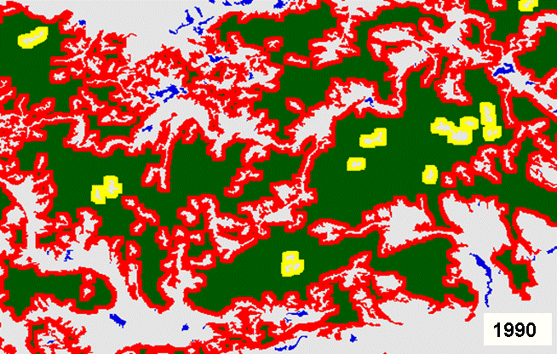
2007
Background / Motivation: MSPA 1
1990
2000
Slovakia (CLC):
change!
Mapping spatial patterns with morphological image processing (Vogt et al., Landscape Ecol. (2007) 22:171–177)
19

Slide 20
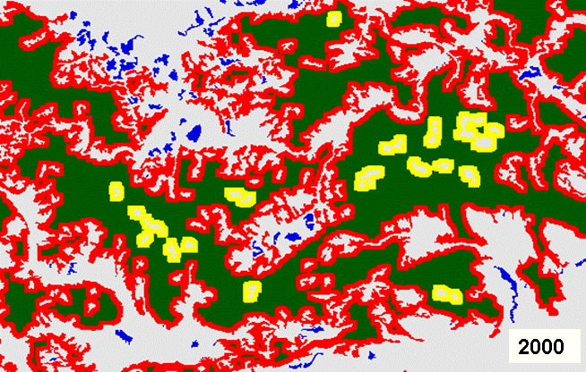
2007
Background / Motivation: MSPA 1
1990
2000
Slovakia (CLC):
change!
Mapping spatial patterns with morphological image processing (Vogt et al., Landscape Ecol. (2007) 22:171–177)
20

Slide 21
2007
Background / Motivation: MSPA 2
4. FSP = f (morphology); (Vogt et al. 2007):
9 classes:
Core, Patch, Perf., Edge (Branches, Shortcut, Corridor).
Pro: more classes, structural connectivity
Con: new concept, not well known yet…
21

Slide 22
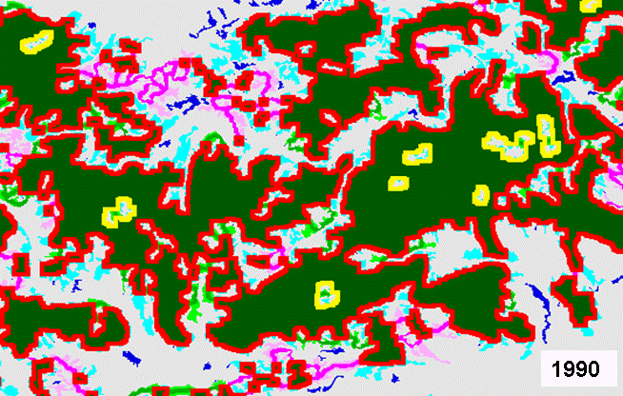
2007
Background / Motivation: MSPA 2
Core
Patch
Perforated
Edge
Branch of Edge
Shortcut
Branch of Shortcut
Corridor
Branch of Corridor
Mapping landscape corridors (Vogt et al., Ecological Indicators (2007) 7:481-488)
22

Slide 23
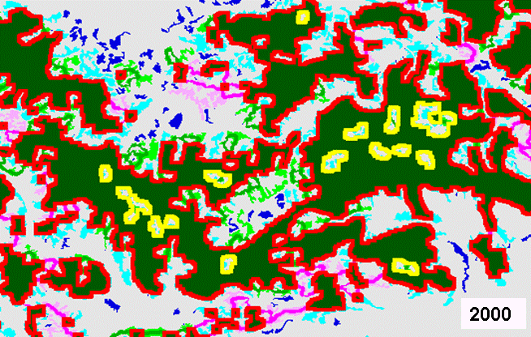
2007
Background / Motivation: MSPA 2
Core
Patch
Perforated
Edge
Branch of Edge
Shortcut
Branch of Shortcut
Corridor
Branch of Corridor
Mapping landscape corridors (Vogt et al., Ecological Indicators (2007) 7:481-488)
23

Slide 24
2008
Background / Motivation: MSPA 3
5. FSP = f (morphology); (Vogt et al. 2008):
7 base classes:
Core, Islet, Perforation, Edge (Branch, Loop, Bridge)
Improvement: 8/4-connectivity, geodesic distance,
new: internal/external, Perforation, Core-connectivity
24

Slide 25
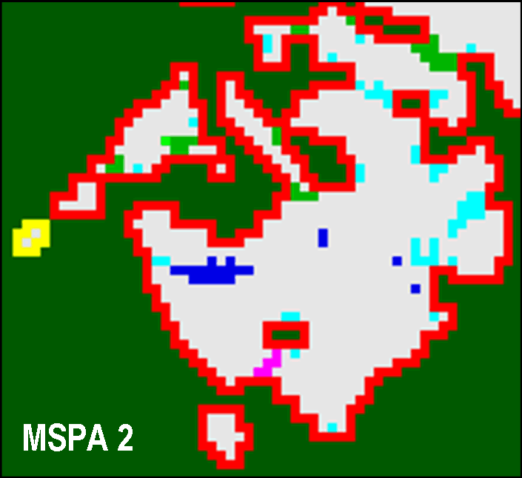
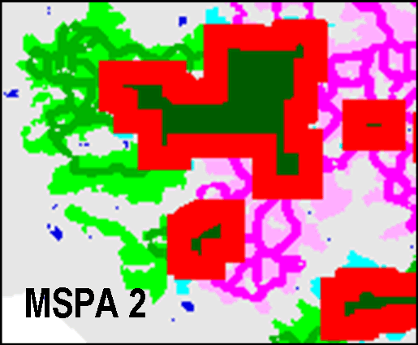
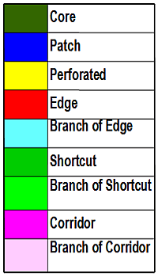
2008
Background: MSPA 2 MSPA 3
↔
Improvement: 8/4 FG-connectivity, geodesic distance,
new: internal/external, Perforation, Core-connectivity
25

Slide 26
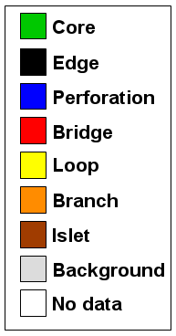
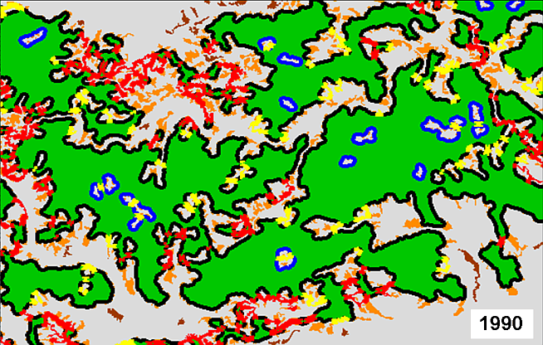
2009
Background / Motivation: MSPA 3
Morphological segmentation of binary patterns (Soille & Vogt, Pattern Recognition Letters (2009) 30:456–459)
26

Slide 27
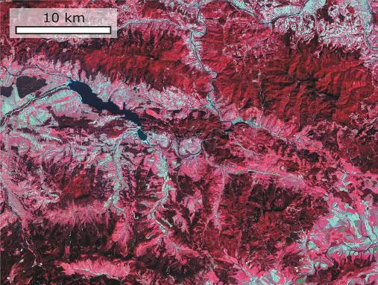

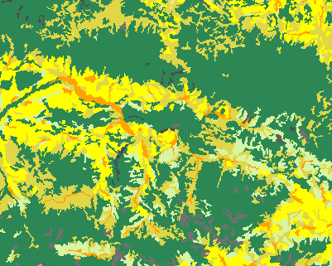
Processing principle: 3 steps
1. input
2. foreground/background
Any digital-data, species
distribution, dispersal, …
Binary mask: forest, habitat,
grassland, movement, …
27

Slide 28
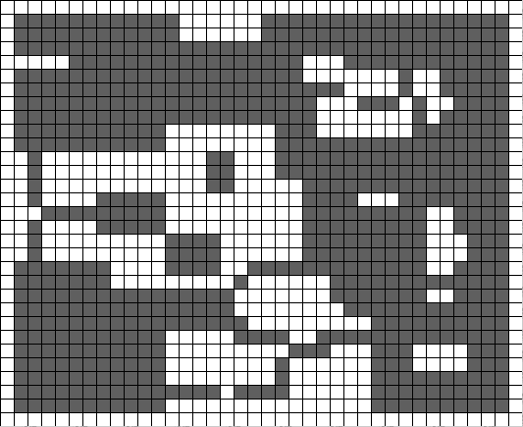
Processing principle: 3 steps
3. spatial pattern (SP) / connectivity
INPUT:
Foreground: forest
Background: non-forest
28

Slide 29
Processing principle: 3 steps
3. spatial pattern (SP) / connectivity
OUTPUT:
CORE: interior area of forest patch excluding forest perimeter
ISLET: disjoint and too small to contain Core
LOOP: connected at more than one end to the same Core patch
BRIDGE: connected at more than one end to different Core patches
PERFORATION: internal patch perimeter
EDGE: external patch perimeter
BRANCH: connected at one end to Edge, Perforation, Bridge, or Loop.
29

Slide 30
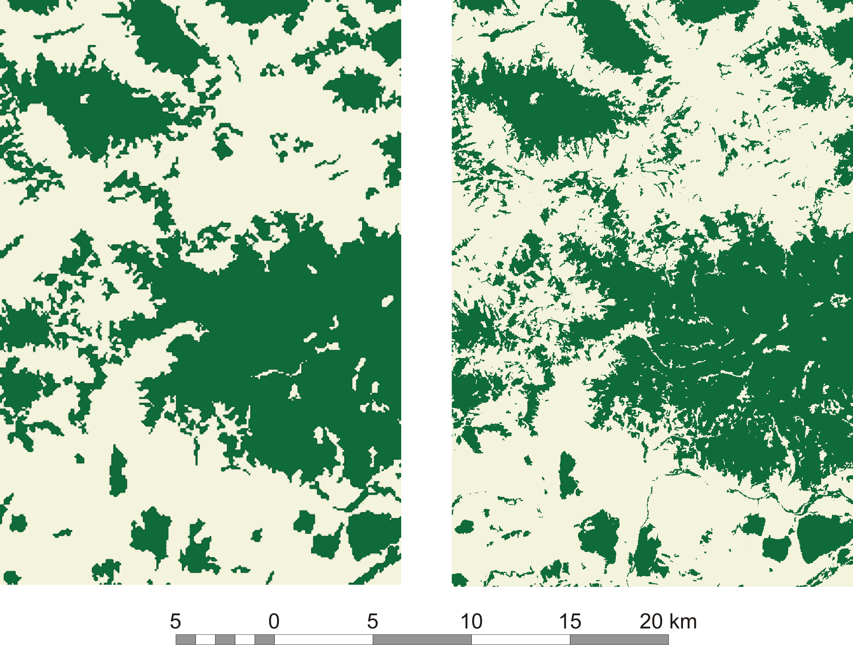
MSPA = f(thematic and spatial detail)
Forest mask: CORINE LC (100m) Landsat (25m)
MSPA = f()
- spatial detail,
- FG-definition,
- Data scale,
- Analysis scale
CORINE: low spatial detail, 40+ land cover classes
Landsat: high spatial detail, usually only 3 forest types
Forest mask: which land cover qualifies for forest?
30

Slide 31
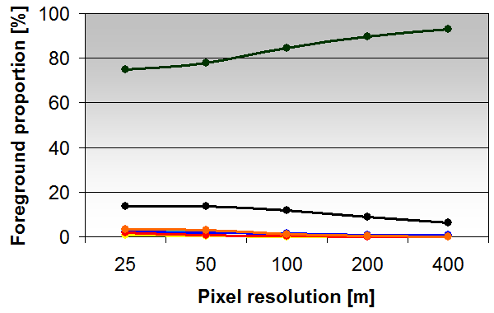
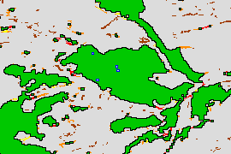
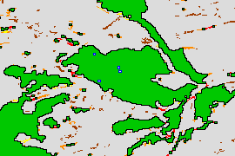
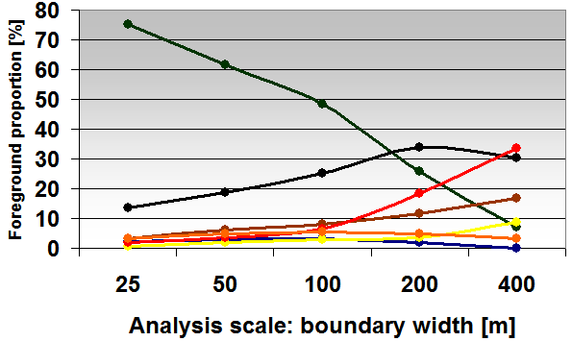
MSPA = f(Scale in raster grids)
- Data scale: upscale pixel resolution
- Analysis scale: vary MSPA edge width
1. Fixed analysis scale &
variable data scale:
1 16 pixels ⬄
25 400 m resolution
2. Fixed data scale &
variable analysis scale:
1 16 pixels ⬄
25 400 m edge width
Impact of scale on morphological spatial pattern of forest (Ostapowicz et al., Landscape Ecology)
31

Slide 32
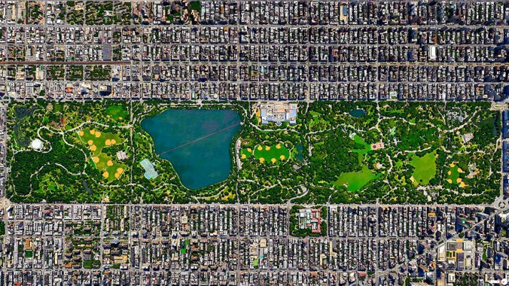
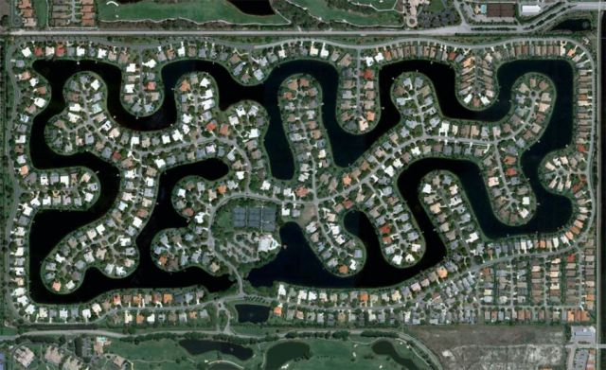
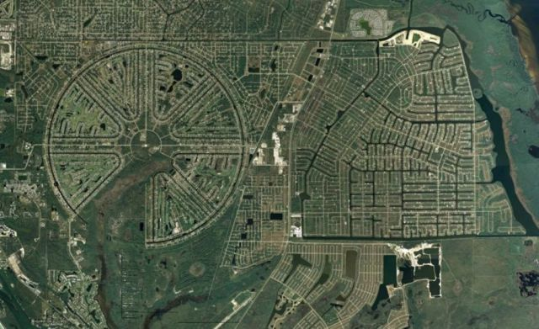
Pattern analysis examples…
2005 - present

Slide 33
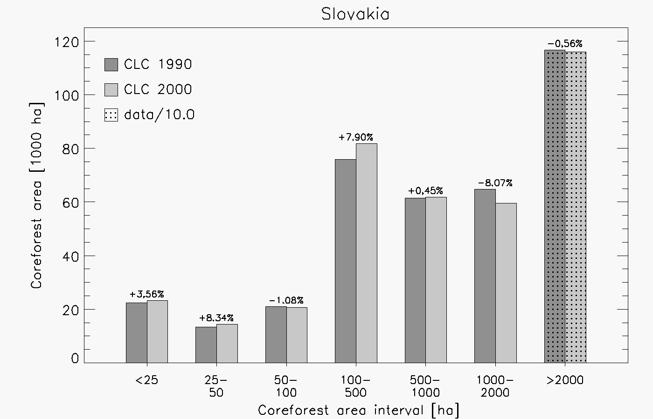
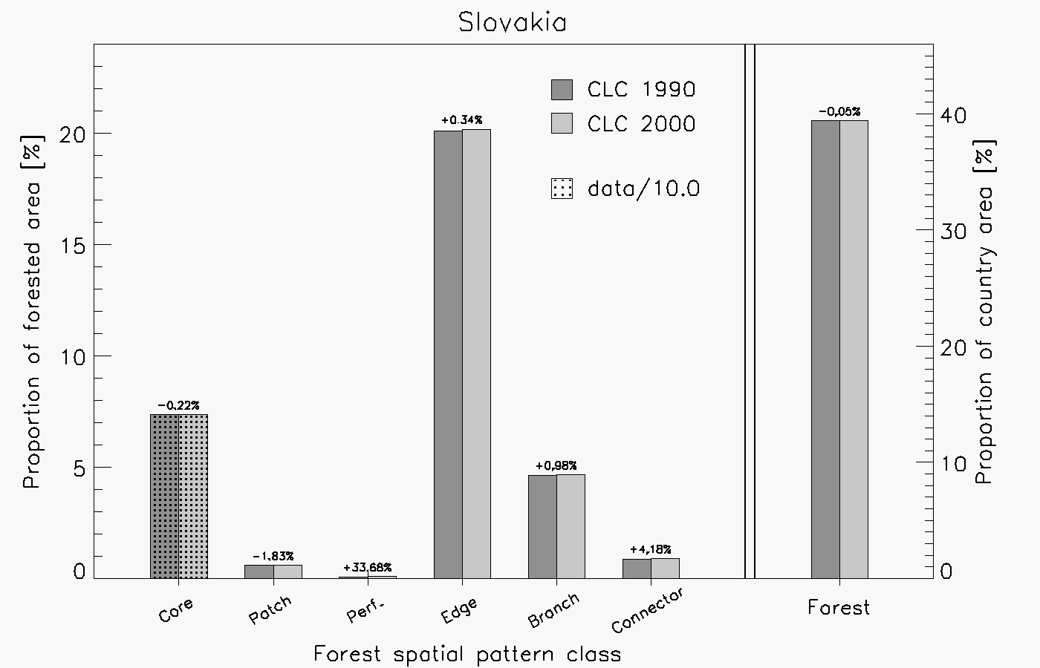
2005
MSPA example: Forest reporting in Slovakia
2004: ‘average patch size’, total forest area: constant
Suggestion: (core-) forest histogram, FSP-classes, and map
1. Histogram: decrease of large/ increase in small forest units
2. FSP-classes: increase in edge, branch, and perforation.
3. Map: overall spatial arrangement and location of changes
33

Slide 34
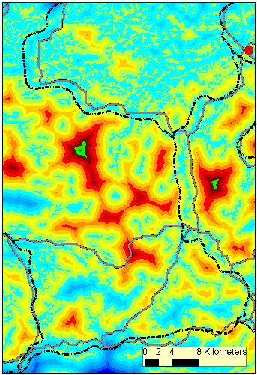
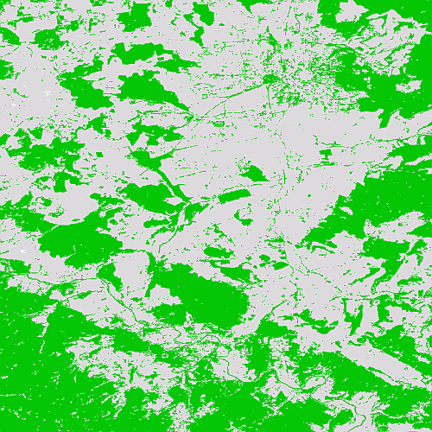
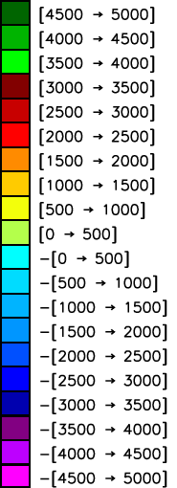
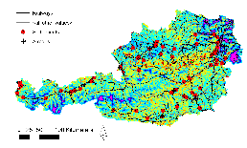
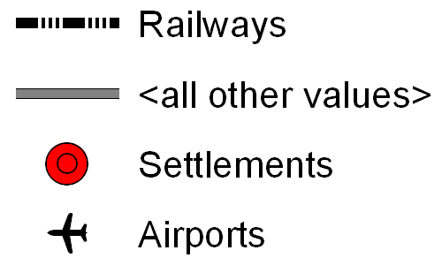
2009
Example: forest compactness (morph. distance)
Distance: Forest/Nonforest boundary
Depth [m]
/motorways
Forest mask Austria
34

Slide 35
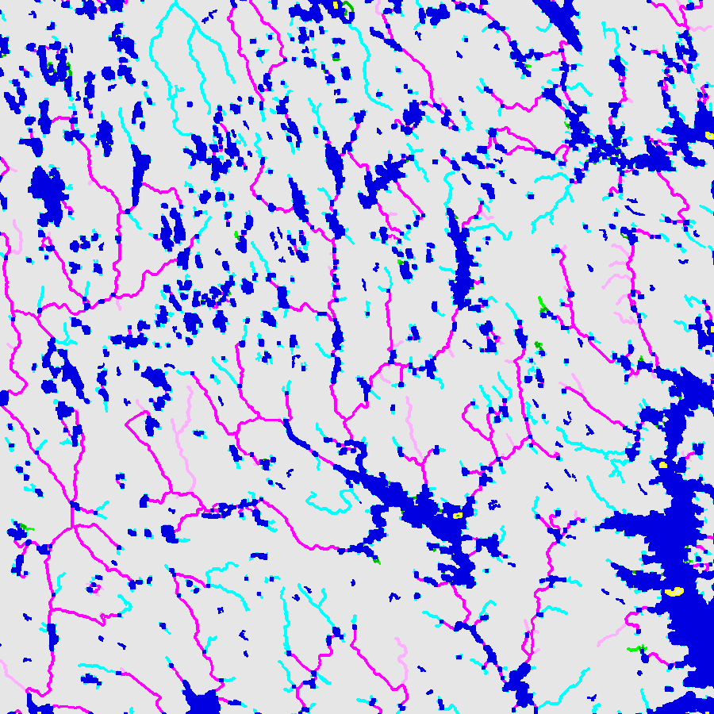
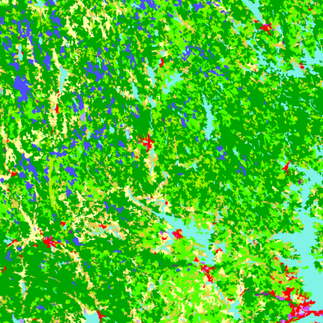
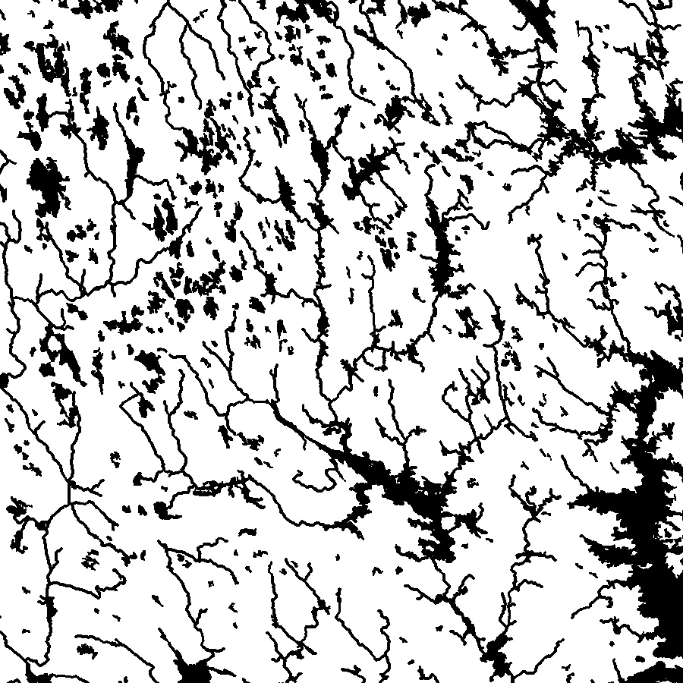
2009
MSPA example: rivers & wetlands, Finland
1. CORINE LC
Wetland
Island
Feeder
Corridor
BrCorr
Creek
2. Add river mask
BrCreek
3. classification, amend legend
35

Slide 36




err
MSPA examples: structural pattern
Forest decline…
err
Manufacturing…
Geometry, medical…
36

Slide 37






err
US-EPA: Enviroatlas
MSPA: US-EPA
Green Infrastructure
Conservation, habitat restoration/protection, water quality
Wickham et al. (2010): US GI Assessment
Analyze maps for conservation, landscape planning, ecosystem services.
Source: NLCD (30 m) Application fields:
- MSPA + GIS: maximize benefits, add value to interpretation
- evaluate urban growth, land trusts in guiding land purchase
- Data Envelopment Analysis (DEA):
evaluate efficiency of decision making units. Non-parametric distance function to rank parcels for conservation
DEA: NY watershed
37

Slide 38







EFETAC
err
MSPA: US-FS
Disease spread: disease/alien species spread models simulate infection/spread scenarios. MSPA: detect narrow pathways to combat spread, evaluate costs and efficiency using simulation models & including ancillary data sources
30 m
60 m
120 m
240 m
AK HI PR
AK HI PR
AK HI PR
AK HI PR
Forest/Grassland: f(edge width, State), data source: 2001 NLCD.
38

Slide 39


Automatic zooplankton recognition
2015
Zooplankton:
small animals (~0.2-2 mm)
very limited swimming capabilities
inhabiting all oceans and very important for the trophic chain
The LOKI (Lightframe Onsight Keyspecies Investigation) system images zooplankton in very fine spatial resolution
MSPA analysis and other predictors
apply machine learning approach to automatically identify plankton types
Improved automatic identification
J. Barette
Deploying LOKI in the Arctic from the Amundsen icebreaker

Slide 40








Automatic zooplankton recognition
2015
LOKI greyscale -> binary image
MSPA to classify different body parts/textures of organisms
Species-specific Bridge/Core ratios are used as predictor in “facial recognition” for zooplankton
Mysid (opossum) shrimp
Adult stage of copepod, extremely important in the food chain since it has vast lipid reserves
Nauplius larvae stage of copepod, very small (~0.2mm)
Jellyfish
Moritz.Schmidt@takuvik.ulaval.ca

Slide 41





err
Pattern Maps & Statistics
MSPA maps
GoogleEarth
EFDAC map viewer application
EU: 2000, 2006 (25 m), USA: 2001 (30 m)
Global: 2005, 2009 (300 m)
Tree species atlas
41

Slide 42




3) From structural to functional pattern …
2009

Slide 43


2009
err
MSPA: structura/functional pattern
Structural pattern: map of forest, grass-, wetland, habitat, etc.
err
not connected
A
B
connected
Structural map
Functional pattern: map of movement, dispersal, telemetry, etc.
connected
a
stepping stones
b
Functional map
43

Slide 44




2009
err
Functional pattern: Delmarva peninsula, MD
Movement pattern
Core
Perfo-
ration
1
Edge
NLCD LC
movement
Branch
Foreground (movement)
2
Loop
Background (forest habitat)
Other land cover
Bridge
Dispersal simulated for a
small forest dwelling mammal
using the J-Walk model.
forest
patch
Gardner & Gustafson 2004, Simulating dispersal of
reintroduced species within heterogeneous landscapes.
Ecological Modelling 171: 339–358
Mapping functional connectivity
(Vogt et al., Ecol. Indicators, 2009)
44

Slide 45


4) Combining pattern with connectivity…
2010

Slide 46




2010
err
MSPA Graph Theory
46

Slide 47



Pattern Analysis (MSPA)
Graph (Network) Theory
err
!
pixel-level information: describe & quantify
geometric properties of image objects
area, shape, size, convexity, topology,
distance measures (internal-external)
compactness (fragmentation/perforation)
variable Edge-Width, 4/8-connectivity
geographic map product, localize hotspots
qualitative connectivity (internal-external)
idealized model of pairwise relations of Nodes (Cores) & Links (Bridges)
undirected, (un-)weighted graph
quantitative connectivity analysis
Detect but not analyze connectors
Not detect but analyze connectors
47

Slide 48
Saura & Rubio 2010 Ecography
err
Conefor
dPC_{k} = dPCintra_{k} + dPCflux_{k} + dPCconnector_{k}
Probability of Connectivity (PC) = Intranode connectivity + flux to/from node + connectivity for other nodes
Intra: Habitat resource within a patch
Flux: How well connected is the patch
Intra: Patch importance for the others to remain connected
ECA (Equivalent Connected Area):
Area of a fictive single habitat patch
providing the same amount of
reachable habitat as the
current set of patches.
Saura et al. 2011 Ecol.Ind.
48

Slide 49


2011
err
MSPA Graph Theory
Saura et al, 2011, Forest Ecology and Management, Key structural forest connectors can
be identified by combining landscape spatial pattern and network analysis.
49

Slide 50










Pattern/Connectivity: applications

Slide 51



5) Change Analysis…
2011

Slide 52
Post-classification change detection
FOREST Changes are differences in FOREST classification of the radiometric data at two times
FOREST Classification is done independently for each image and thus changes in classification results are not necessarily equivalent to changes in radiometric data
FOREST Classification accuracy is a function of sensor quality, acquisition season, atmospheric conditions and availability of training data, etc.
FOREST Classification Changes contain unwanted elements enhanced by misregistration and noise.
28 April 2016

Slide 53






Forest Cover Change
Synthetic Sample1
Synthetic Sample2
Forest
Changes:
Gain
Loss
No changes:
Forest
Non-forest
28 April 2016

Slide 54




Step 1: Identify Change “Hot Spots”
Synthetic Sample 2
moderate
DISTANCE to Forest Boundary
(morphological erosion)
intermediate
SEEDS of major changes
Forest Gain
Forest Loss
Forest stable
Non-forest stable
rigorous

Slide 55


Step 2: Reconstruct
Step 3: Fill small holes
Change layer
morphological reconstruction
by dilation
morphological filling
Final change product
Reconstructed
Change Objects
Change seeds
Forest Changes:
Gain
Loss
28 April 2016

Slide 56


err
Forest Cover Change Analysis (FRA 2010)
56

Slide 57



Change Detection: essential gain & loss areas, Elasticity
Simple difference
Forest loss areas
Forest gain areas
Remove unwanted spurious changes
FAO FRA 2010
Seebach, L. et. al (2013). Enhancing post-classification change detection
through morphological post-processing – a sensitivity analysis. Intl. J.
Remote Sensing, 34 (20), 7145–7162. DOI: 10.1080/01431161.2013.815382
Riitters, K. et. al (2015). A global evaluation of forest interior area dynamics using tree cover data from 2000 to 2012. Landscape Ecology.
DOI: 10.1007/s10980-015-0270-9
57

Slide 58



6) Fragmentation Analysis…
2014

Slide 59
Fragmentation: why is it important and how to measure?
Assess dynamics/impact of land cover/type changes and risk studies
Measure progress in political directives and ecological programs
Definition: Degree to facilitate the movement for a given species
Frag = f(patches, shape, connected, perforation, dispersion, etc.)
Duality: forest is fragmented by which other land-cover types?
Summarize its components (# of patches, shape, perforation, etc.)
Generic, geometric, holistic approach
Aim: generic, normalized [0,100]%, spatial index
applicable to all data sources, scale-independent, allowing to
directly compare the degree of fragmentation of different sites
measure/quantify temporal changes on a given site
image index averages out essential information/may be misleading
detect fragmentation hotspots & measure/quantify local changes

Slide 60





Degree of fragmentation [0, 100]?
Fragmentation = 1 - Aggregation
→
Compact
Regular
100
Fragmentation [%]
50
Cover [%]

Slide 61


Fragmentation = f(Contagion)
Local clumpiness: moving window of pre-defined size, i.e. 50 x 50 pixels
Forest pixels intersection types in cardinal directions
Contagion:
# F-F / (# F-F + # N-F)
= 5/11 = 0.4545
Maximum contagion: 1
Minimum contagion: 0
1
6
5
Fragmentation = 1 – Contagion
(mapping Foreground only)

Slide 62






Fragmentation = f(Entropy)
Entropy: degree of information content ~ irregularity/disorder
Increase of disorder/randomness/complexity/Entropy
Fragmentation = (Emed – Emin)/(Emax – Emin)
Emin
Emed
Emax
P: probability of cell|cell
difference in all 8 directions

Slide 63




Fragmentation = f(Hypsometry/Bathymetry)
foreground/background
Average Distance in Foreground (adf):
rough guide for fragmentation
Hypsometric curve: normalized
cumulative frequency
Pseudo elevation map
Ocean | Land

Slide 64


Normalized Hypsometric curve: Normalized fragmentation range:
Minimum
Foreground fragmentation
Background fragmentation
Potential range
Maximum
minimum
intermediate
maximum
1-Amin
1-A
1
Frag(bg/fg) = [1-Amin, X, 1]

Slide 65



























RULE model = f(P,H)
P: forest amount
H: forest adjacency
R.H. Gardner, 1999
P95
P75
chboard
random
compact
P50
P25
P05
H00
H25
H50
H75
H100

Slide 66




Contagion
Entropy
Summary
- Fragmentation = f(Contagion, Entropy,) [Map]; Hypsometry [index]
- Range of foreground cover P: [5, 25, 50, 75, 95]%
- Range of connectivity H: [0, 25, 50, 75, 100]
- Boundary conditions: checkerboard, random, compact

Slide 67


Fragmentation(Entropy) on forest mask (Copernicus 2012)
0%
100%

Slide 68





Fragmentation
Quantitative forest degradation [%]
Measure fragmentation
geometric concept
not species specific
monitor & quantify
compare maps
measure progress
in political programs
and directives.
Vogt, P. (2015): Quantifying landscape fragmentation. Anais XVII Simpósio Brasileiro de Sensoriamento Remoto - SBSR, pp. 1239-1246, João Pessoa-PB, Brasil, 25 a 29 de abril de 2015, INPE

Slide 69





7) Cost Analysis…
2015
Least Cost path/map / geodesic distance
Human settlements

Slide 70


Input: resistance map + marker map
Cost Analysis via geodesic time
A
C
B
Byte image: i.e. land cover map with species-specific resistance values for each land cover class
A: 1 byte, mandatory
B: 2 byte, optional
C: 3 byte, optional: missing/avoid

Slide 71


Output: cost map A cost map AB (incl. LCP)
Cost Analysis via geodesic time
Cost Map starting from object A
Combined Cost Map of objects A and B

Slide 72


Output: cost map AB cost zones in map AB
Cost Analysis via geodesic time
Least cost path bypassing an obstacle
user-driven ranges: small/medium/large

Slide 73







err
Generic Geometric Image Object Analysis
Object analysis: forensic, security, robotics, meteorology, thermal, radar, astronomy, neuroscience, …
Users: industry, science, politics, management, …
Data: availability, cost, quality, content, scale, preprocessing, …
Understanding: natural-human processes, economics, health,
threat assessment, …
Radar
Thermal
Sonar
Neuroscience (CT)
X-ray speckle pattern of an alloy
73

Slide 74






err
Generic Geometric Image Object Analysis
etc.
generic & scale independent image object analysis
74

